Slide 1
Learn by Example
Kickoff Agenda
Developing basic software developing basic skills required to build Cognitive AI applications

Slide 2
Agenda
Introductions (10 minutes) ScrumMaster
Workshop Agenda (10 minutes) Product Owner
Teamwork (10 minutes) ScrumMaster
Next Steps (5 minutes) Product Owner

Slide 3
Introductions

Slide 4
Agenda
Introductions (10 minutes) ScrumMaster
  What is your name
  What do you hope to get out of this workshop
  What software background do you have already
Workshop Agenda (10 minutes) Product Owner
Teamwork (10 minutes) ScrumMaster
Next Steps (5 minutes) Product Owner

Slide 5
Reedy Feggins, IBM Solution Architect
Who am I
IBM Solution Architect with over 20 years working in the software development industry. Currently working as IBM Cloud Garage Architect
Agile Coach responsible for teaching teams (small and large) how to develop software successfully
Certified ScrumMaster, SAFe Certified Program Manager, IBM Cloud Certified Developer

Slide 6

IBM Cloud Garage

Slide 7
Workshop Participants

Slide 8
Workshop Agenda

Slide 9
Agenda
Introductions (10 minutes) ScrumMaster
Workshop Agenda (10 minutes) Product Owner
  What and why are we doing this?
  How are we going to make this happen?
Teamwork (10 minutes) ScrumMaster
Next Steps (5 minutes) Product Owner

Slide 10

Demonstrations
IBM Watson Assistant

Slide 11
Teamwork

Slide 12
Agenda
Introductions (10 minutes) ScrumMaster
Workshop Agenda (10 minutes) Product Owner
Teamwork (10 minutes) ScrumMaster
  How are we going to work together? (5 mins)
  Roles – who is doing what? (5 mins)
  What tools will we be using:
Next Steps (5 minutes) Product Owner

Slide 13
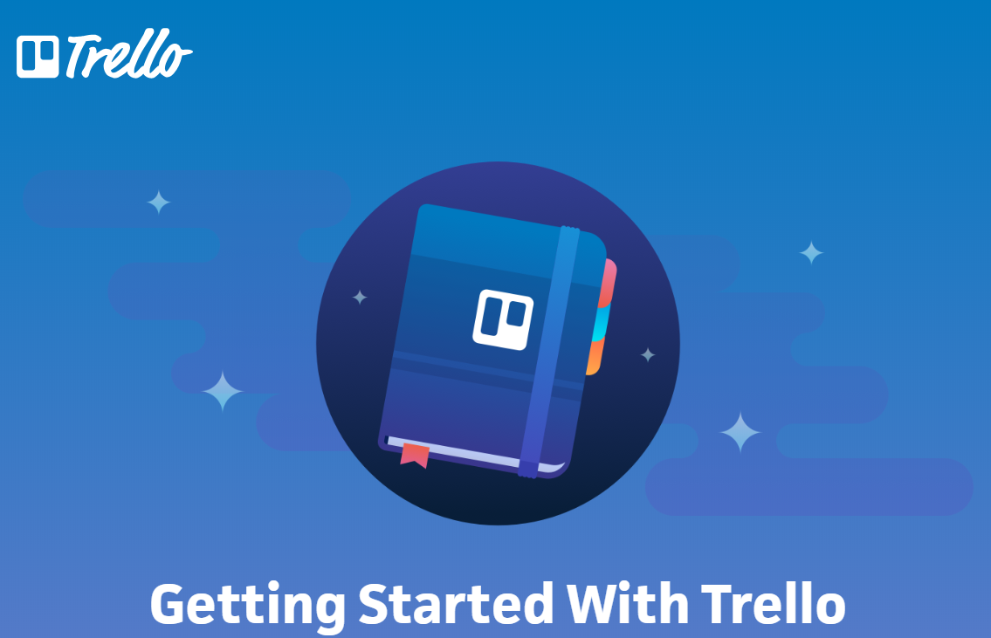
Using Trello
Trello’s simple web-based collaboration tool used to help teams organize everything from the day-to-day operations of a software team to your high school projects
Useful links
Trello 101 https://trello.com/guide

Slide 14
Zoom

Slide 15
git

Slide 16
Next Steps

Slide 17
Agenda
Introductions (10 minutes) ScrumMaster
Workshop Agenda (10 minutes) Product Owner
Teamwork (10 minutes) ScrumMaster
Next Steps (5 minutes) Product Owner
What haven’t we told you?
How do we keep momentum?

Slide 18
Next Steps
Scrum Master
Add Team Members to Trello Board
Setup Team Calls for next week
Send out Calendar Invites
Team Member
  Sign up for IBM Cloud, https://www.ibm.com/cloud/
  Read about AI at IBM https://www.ibm.com/cloud/ai
  Walk thru Watson Assistant Demo https://www.ibm.com/cloud/watson-assistant
  Sign up for GitHub https://www.github.com
  Take a look at the code for sample app https://github.com/watson-developer-cloud/assistant-simple
  Sign up for Workshop Courses See ScrumMaster for current list
  Start Design Thinking Course

Slide 19
Questions and Answers (Q&A)

